Slide 1



Conducting Applied Research in the Field of Vocational Rehabilitation: Strategies and Challenges in Studying Emerging Models
September 12, 2018 1:00pm
Presenters:
Kelly Haines, Allison Taylor, & Ngai Kwan

Slide 2

Langston University Rehabilitation Research and Training Center
(LU-RRTC) and Research and Capacity Building for Minority Entities
Collaborative effort between the Institute for Community Inclusion, University of Massachusetts, and the LU-RRTC.
The RRTC is funded through the National Institute on Disability Independent Living and Rehabilitation Research (NIDILRR)
Mission: To improve Minority Entities’ disability and rehabilitation research capacity and infrastructure by conducting a programmatic line of research examining experiences and outcomes of persons from traditionally underserved racial and ethnic populations and communities and capacity-building efforts.
PI: Dr. Corey L. Moore, CRC
Delta Sigma Theta Sorority, Inc.
Distinguished Professor Endowed Chair & Principal Investigator/Research Director
Rehabilitation Research and Training Center (RRTC) on Research and Capacity Building for Minority Entities
Email: clmoore@langston.edu
Website: http://www.langston.edu/capacitybuilding-rrtc

Slide 3
Objectives for today
Describe two federally-funded research studies that examine emerging models in employment services that aim to improve outcomes for individuals with disabilities
Outline implementation strategies that supported applied research in the field of vocational rehabilitation
Consider how quantitative approaches underpinned each effort
Notes:
So hopefully audience members can apply knowledge gained in your next grant application or in current research efforts

Slide 4
Applied Research Example: Progressive Employment
NIDILRR-funded research study under RRTC on Demand-Side Strategies
Project objectives:
  Define and extract the PE model
  Replicate it other states
  Evaluate the results
Notes:
How we pitched it
How we carried out the research agenda
What we learned

Slide 5
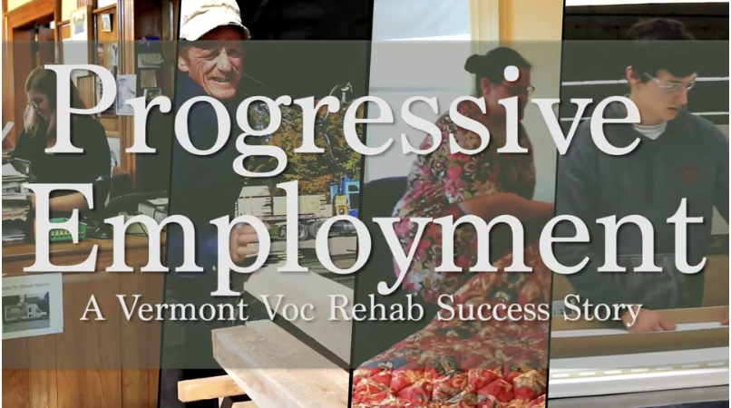
The Pitch
Making the case for studying an emerging model
Fitting into the overall research agenda
Notes:
3 studies in partnership w/ SVRAs; 3 “traditional” approaches: survey, case study, secondary data analysis
Overview of the model
Supporting evidence

Slide 6

Partnership
State Vocational Rehabilitation Agency as a project partner
  Contractual relationship managed by ICI as primary grantee
  VR agency personnel listed as key project staff

Slide 7
Methodology
Proposed an impact and process evaluation
  5 year work-plan
  Qualitative and quantitative approach to measurement
  Embedded Training, TA, and Dissemination

Slide 8


Step 1. Define and extract
Emerging model
  Define
  Document
  Package

Slide 9
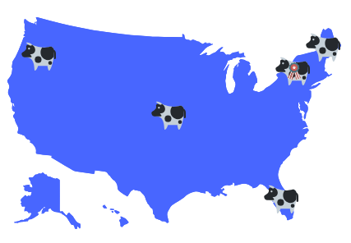
Step 2. Model replication
Engage other agencies to adopt and test the model using a Learning Collaborative approach
Notes:
Project goal: take a model for employment services that emerged in Vermont, replicate and evaluate that model in four other states

Slide 10
Step 3. Evaluate
Impact analysis:
  State driven evaluation plans
  Case file and PE-specific data extracts
Process analysis:
  Monthly phone calls
  1-2x year in-person (site visits)
  Learning collaborative meetings (virtual and in-person)

Slide 11
What have we learned?
Partnership with VR agency as co-researchers
Flexibility of the evaluation plans and specific research questions (by state)
Embedded training and TA, and peer-to-peer support
Early successes and positive preliminary findings
Notes:
The reasons why this research project was such a success: Partnership with VR agency as co-researchers: the model emerged in a VR agency – as opposed to a laboratory; this enabled us to get buy-in from other states to join the research study

Slide 12
Building on success
Currently have 2 additional funding streams to build upon the PE research conducted under the RRTC
Eventually hope to scale up this model and this approach – as in the next example of the SGA project

Slide 13
SGA Project
Model Demonstration
Funded by Rehabilitation Services Administration (RSA)
Goal: Develop and test an employment services model for SSDI beneficiaries that would:
  Enhance engagement in services
  Improve employment outcomes
  Increase chances of earning above the SGA (Substantial Gainful Activity) level
Randomized Control Trial (RCT)
Notes:
The overarching goal of the SGA Project was to improve employment and earning outcomes for SSDI-only clients. Through our evaluation we also wanted to gather information on strategies that can be used to help other state agencies implement SGA innovations in the future

Slide 14


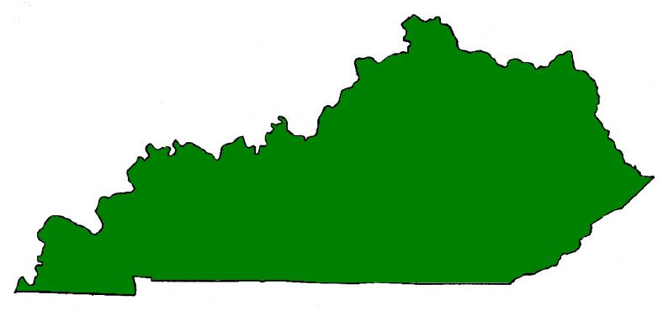

The SGA Project Partners
MN VRS
KY OVR
Notes:
Recruited two VR agencies, in Kentucky and Minnesota, to implement the model
Contracted with Mathematica Policy Research to conduct evaluation

Slide 15
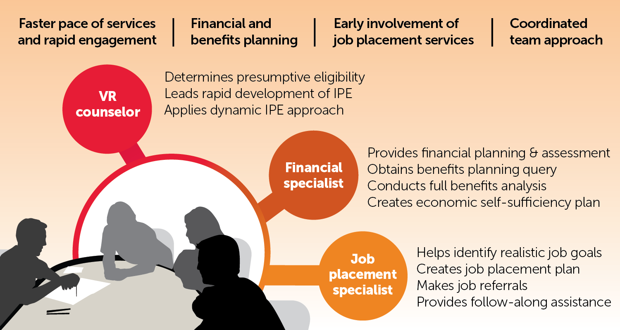

The SGA Project Intervention

Slide 16

Training and Technical Assistance
Statewide launch meetings
Manuals, forms
Regular meetings with VR administrators
Site visits at VR offices

Slide 17
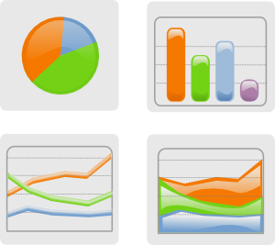

Research Activities
Impact Evaluation
Process Evaluation
Follow-Along Qualitative Study

Slide 18
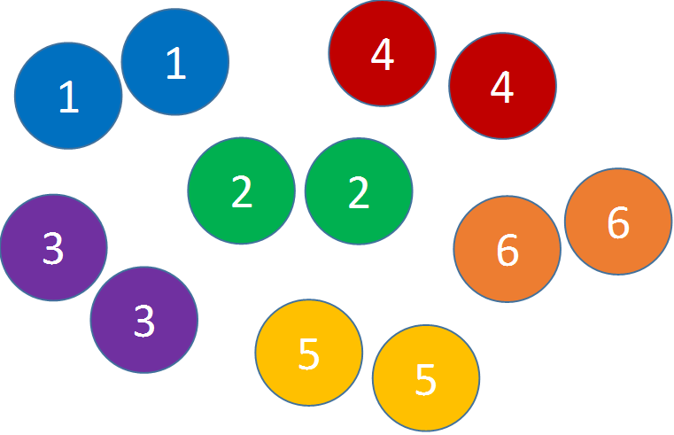
Office-Level Clustered Random Assignment

Slide 19
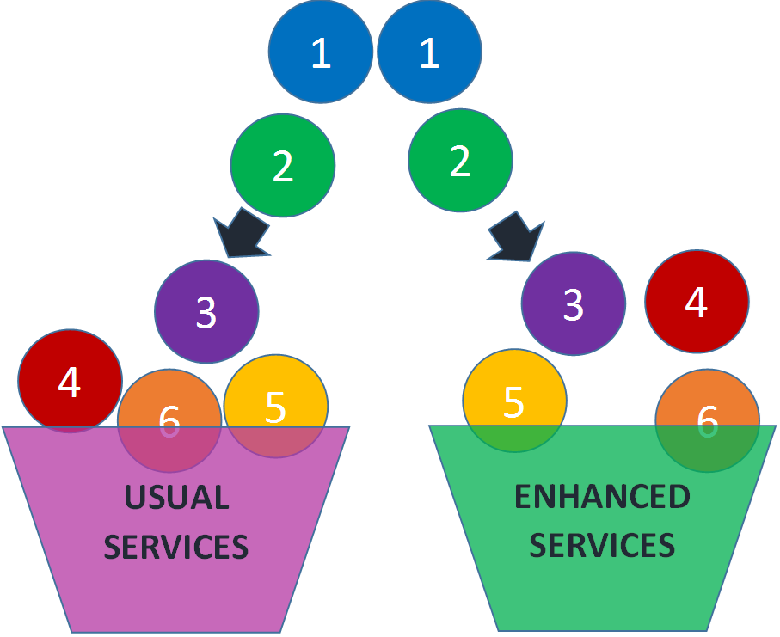
Office-Level Clustered Random Assignment
Notes:
Every SSDI-only customer was part of the study – about 1000 in each state - 500 at Treatment sites (Enhanced), 500 at Control (Usual)

Slide 20
Impact Evaluation
To what extent was the model implemented as designed?
Did outcomes improve?
  Engagement (drop-out rate)
  Employment
  SGA-level earnings

Slide 21
Impact Evaluation:
Data Sources
Case Management Systems (CMS) at VR agencies
  Existing CMS – RSA-911 reporting requirements
  Added fields for SGA project services and milestones
VR agencies shared de-identified data

Slide 22
Process Evaluation
How was the project implemented?
What challenges arose, and how were they addressed?

Slide 23
Process Evaluation:
Data Sources
Document review
Observations of training and TA
Site visits
Interviews with VR leadership and staff

Slide 24
Qualitative Follow-Along Study
What are VR customer perceptions and experiences of employment, job search, VR, and SSDI?
How do they make decisions about returning to work?
What is the role of VR in these decisions?
Notes:
Follow-along study, not an evaluation

Slide 25
Qualitative Study
Sample: 48 participants (SSDI-only VR customers receiving services during demonstration)
Recruitment: coordinated with VR agencies
Methods: 1-3 in-depth telephone interviews
Data Analysis: Ongoing thematic analysis using Atlas.ti

Slide 26
Quantitative Data
How can quantitative data be useful in the study design stage?
Background information :
  Area Demographics
  Local economy
  Past and Current VR client profiles
  VR agency performance
  Example: SGA (identify study sample characteristics using RSA911 data)
Determination of a control group when using a quasi-experimental approach :
  Matching
  Example: PE vs Non-PE clients

Slide 27
Quantitative Data
How can quantitative data be helpful in project implementation stage?
Data Accuracy assurance :
  Compare data collected with existing data
  Construct a trend data pool to monitor the consistency of data collected
  Provide feedback to PI if there are problems with (1) study sample; (2) data quality (missing data; inputting errors); (3) effectiveness of the intervention.
  Example: TPS project

Slide 28
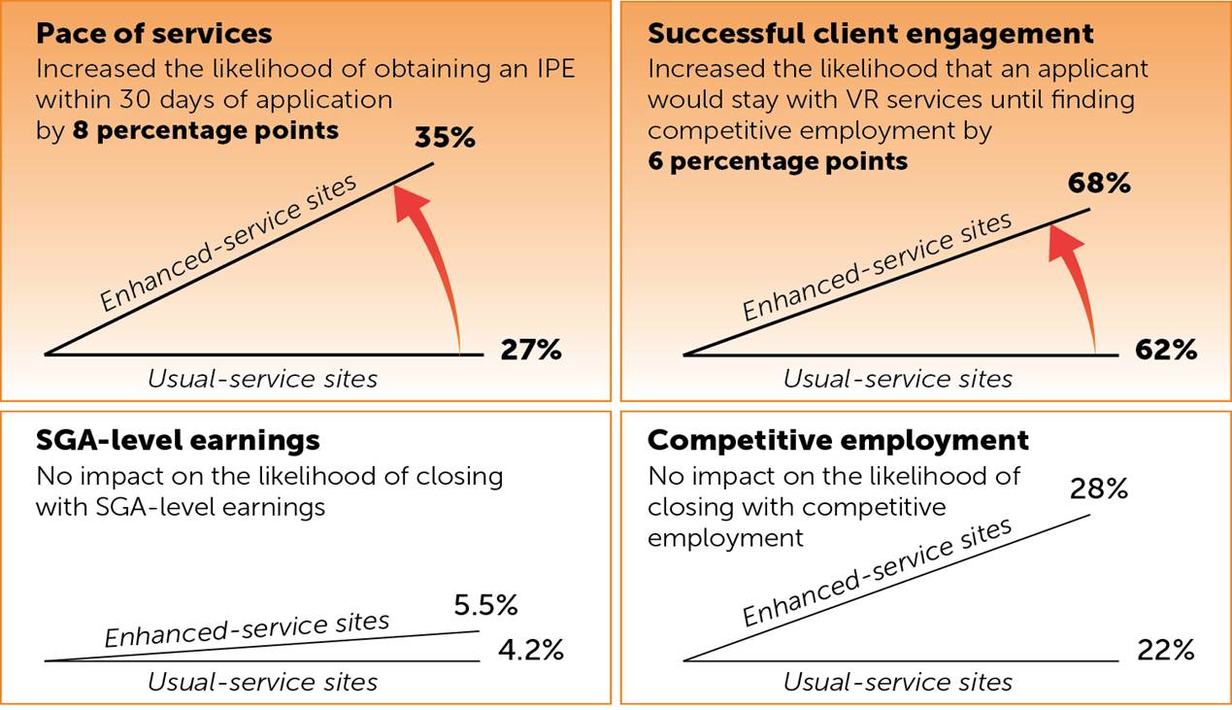
Quantitative Data
How can quantitative data be meaningful in project completion stage?
Knowledge Translation and reports :
  Impact analysis (example: Improved Pace and Engagement in Minnesota)

Slide 29
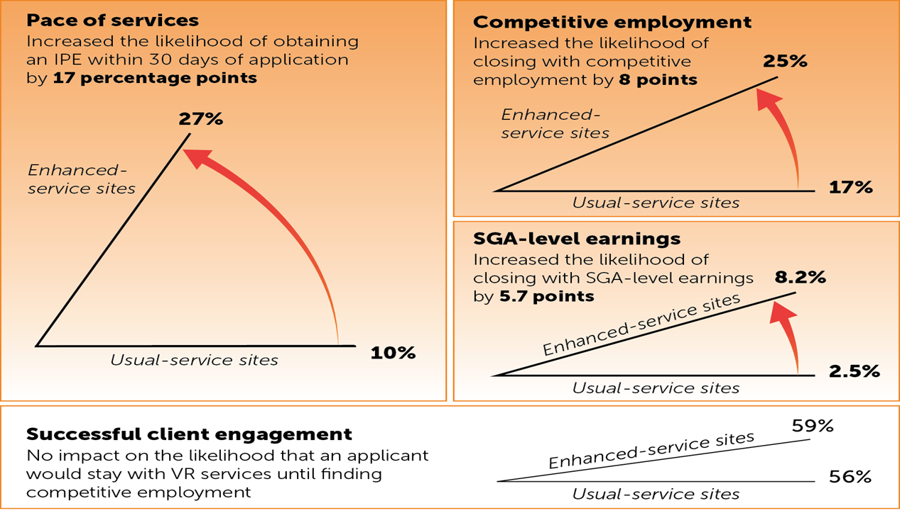
Improved Pace and Employment in Kentucky

Slide 30
Quantitative Data
Journal articles; briefs; web portals
A few things to remember :
Data agreement contract
Data storage and transferring
Data structure
Example :PE project partnering with several state agencies

Slide 31

Learn more
Visit our website:
[www.ExploreVR.org]
Contact us:
  Kelly.Haines@umb.edu
  Allison.Taylor@umb.edu
  Ngai.Kwan@umb.edu

Slide 32

Questions?

Slide 33
Langston University Rehabilitation Research and Training Center
(LU-RRTC) and Research and Capacity Building for Minority Entities
Collaborative effort between the Institute for Community Inclusion, University of Massachusetts, and the LU-RRTC.
The RRTC is funded through the National Institute on Disability Independent Living and Rehabilitation Research (NIDILRR)
Mission: To improve Minority Entities’ disability and rehabilitation research capacity and infrastructure by conducting a programmatic line of research examining experiences and outcomes of persons from traditionally underserved racial and ethnic populations and communities and capacity-building efforts.
PI: Dr. Corey L. Moore, CRC
Delta Sigma Theta Sorority, Inc.
Distinguished Professor Endowed Chair & Principal Investigator/Research Director
Rehabilitation Research and Training Center (RRTC) on Research and Capacity Building for Minority Entities
Email: clmoore@langston.edu
Website: http://www.langston.edu/capacitybuilding-rrtc

Slide 34
Thank you for your participation!!
Please take a few minutes to fill out the evaluation survey:
https://www.surveygizmo.com/s3/4515526/Post-WebinarSeptember-12-2018-Survey

